Slide 1

Leveraging Transfer Learning for NLP

Slide 2
Table of Contents
Introduction to NLP
Transfer Learning
Data
ULM-FiT
Transformers
Further Improvements
2

Slide 3




The GoldSpot Solution: Experience, Expertise, and proven Excellence in Innovation
Continuous success rates and a proven ability to harness data science make GoldSpot the ideal innovation partner.
Reducing the Cost of Exploration
De-Risking Exploration with an AI Approach
AI Driven Resource Investing
Quantamental: Best of both worlds
Lower the cost of exploration with a methodical approach combining the best of people, disciplines, and computing
Reduce bias, increase efficiency, make better use of data collaborating with a team of experts. Explore less to find more
Spend less with data-driven exploration. Discover opportunities faster, and collaborate on harnessing data for investment decisions
Data driven investing by combining traditional investing with more data and AI powered investing engines
3

Slide 4
What is NLP
Using computational techniques to process and analyze natural language data
NLP is very important to businesses as most businesses deal with some form of language data
Areas of NLP include: classification, machine translation, question answering, language modelling, etc.
4

Slide 5
How does NLP fit in with GoldSpot
There is an established link between public sentiment of a financial instrument
For GoldSpot, our investment focus revolves around gold, thus it is very advantageous for us to have a knowledge of the overall market sentiment on gold
Due to the vast amount of data available from public domains such as Twitter, it is infeasible for human analysts to gauge the overall market sentiment at a particular point in time.
By leveraging deep learning, we are able to make accurate sentiment classification at scale, thus giving us an accurate and timely analysis of public sentiment on gold.
5
Notes:
There is an established link between public sentiment of a financial instrument, and its influence on the instrument’s performance. By understanding the public sentiment of a particular financial instrument, we hope to gain insight into its future price movements.
For GoldSpot, our investment focus revolves around gold, thus it is very advantageous for us to have a knowledge of the overall market sentiment on gold.
Due to the vast amount of data available from public domains such as Twitter, it is infeasible for human analysts to gauge the overall market sentiment at a particular point in time. By leveraging deep learning, we are able to make accurate sentiment classification at scale, thus giving us an accurate and timely analysis of public sentiment on gold

Slide 6
Classical Methods for NLP
Bag of words approach – TF-IDF
Relies on human created heuristics for words that doesn’t generalize across different contexts
Why this doesn’t make sense in a financial context
Doesn’t take into account sequential nature of text
Example: Don’t buy A, B is clearly better
6

Slide 7
Modern Approaches
Use deep learning!
Train a neural network on a corpus and let it figure out the semantic relationship between the words
Special NN architectures (RNNs, Transformers) can learn sequential relationships between words
7

Slide 8
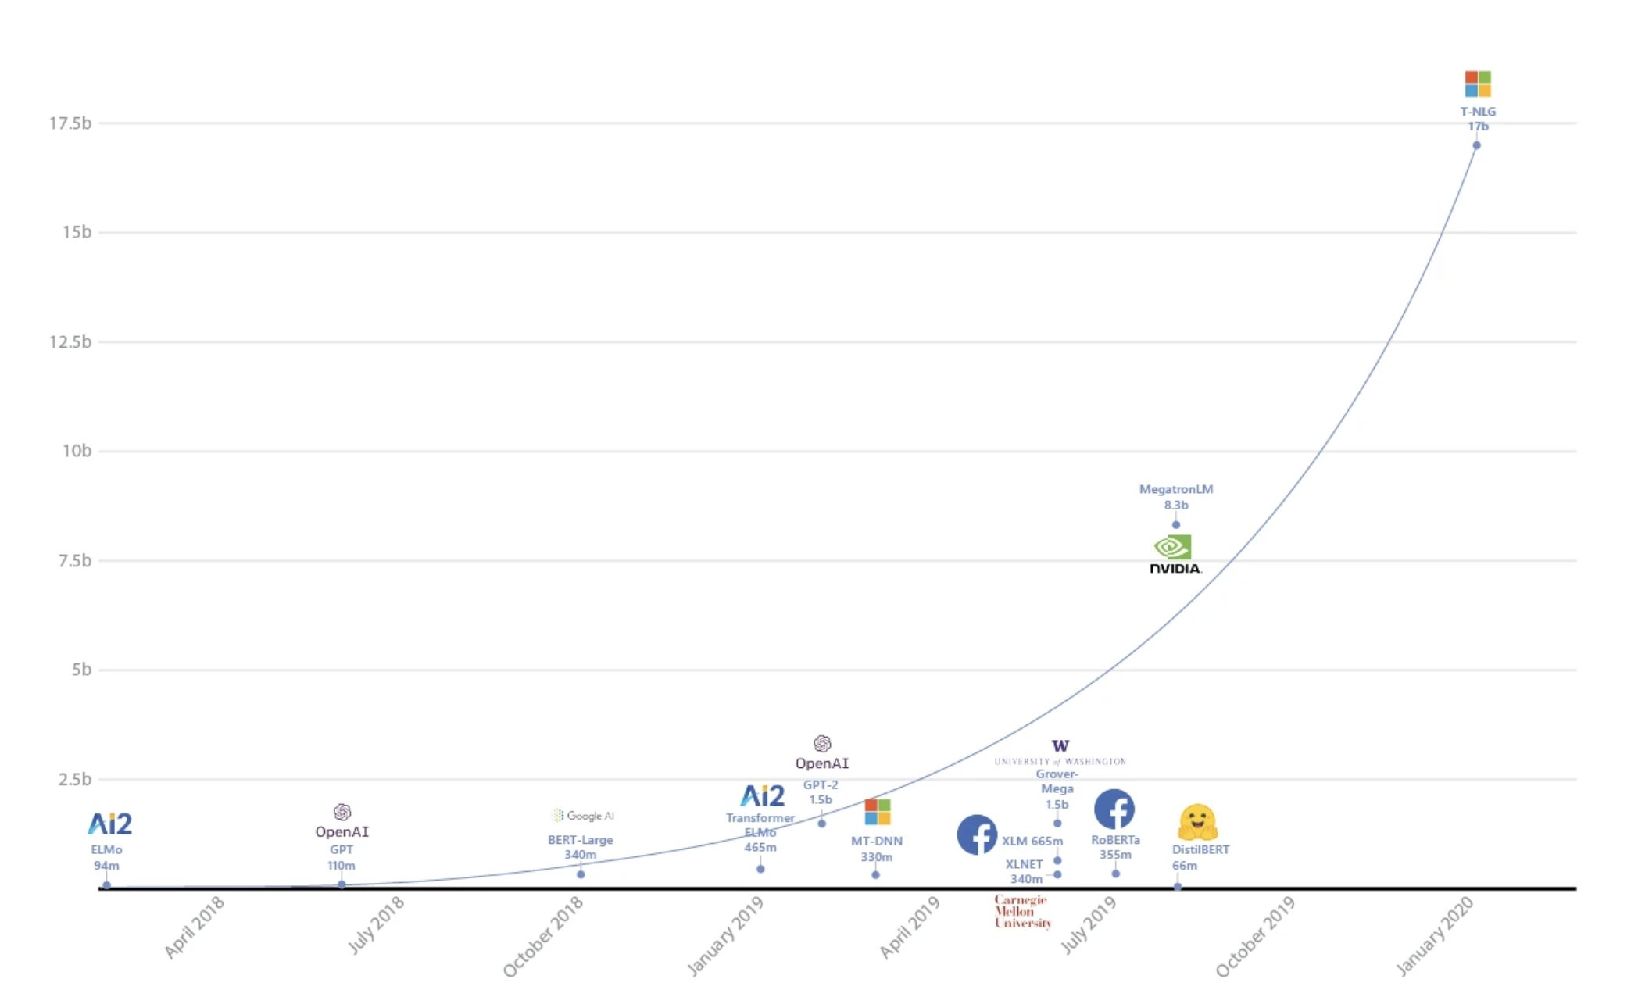
Exponential Growth of NLP Models
8

Slide 9
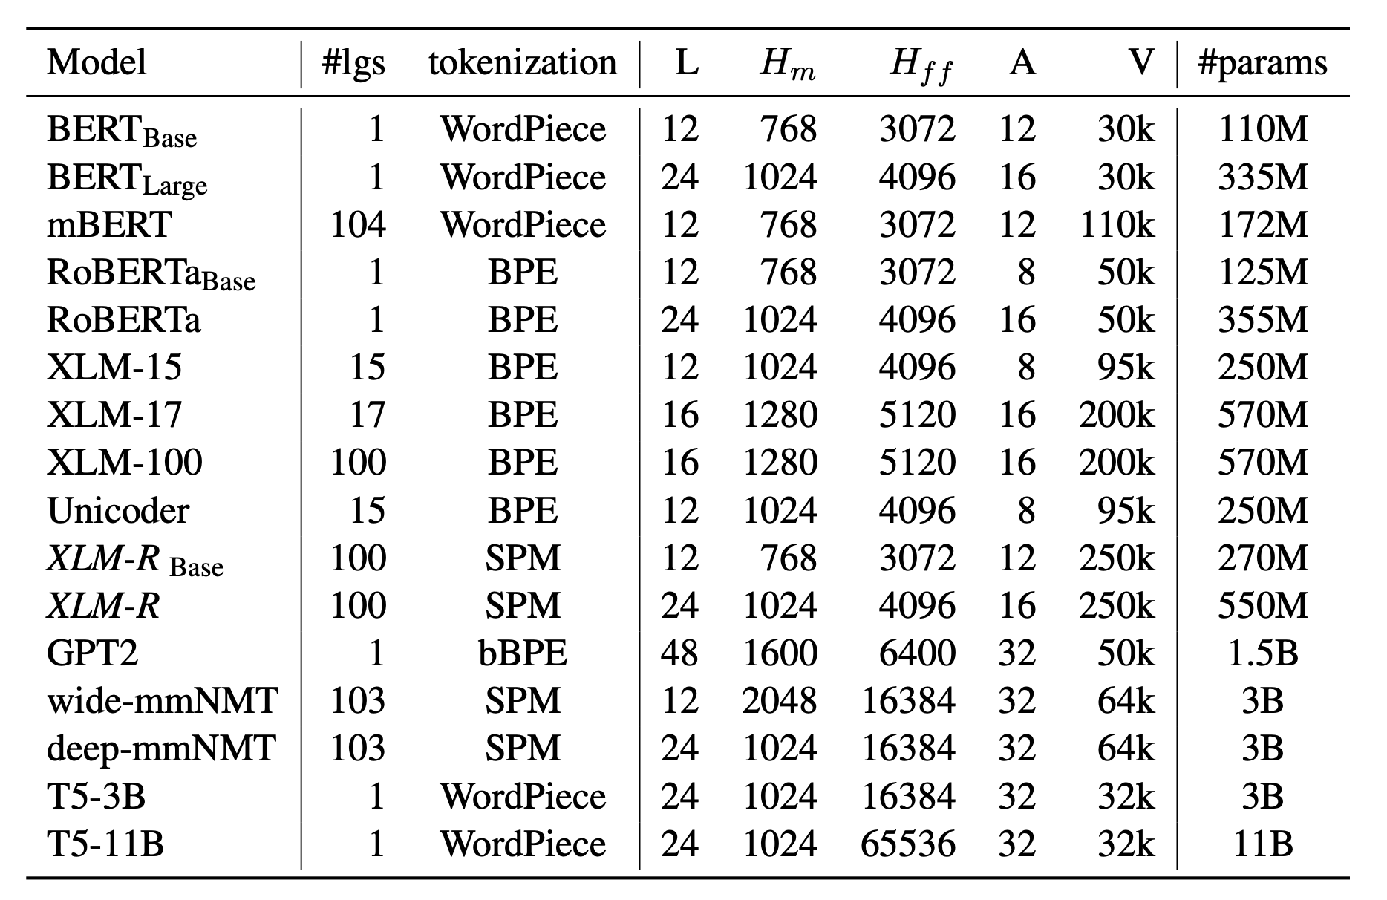
Exponential Growth of NLP Models
9

Slide 10
Leveraging transfer learning
Training large neural networks costs $$$ and takes a long time
Can get up 100’s of millions of trainable parameters
Some of the largest models (GPT2, CTRL, Megatron) have over 1B parameters
Training BERT cost + time (paper)
https://syncedreview.com/2019/06/27/the-staggering-cost-of-training-sota-ai-models/
It doesn’t make sense for us to always train a model from scratch
CV: Train a model on Imagenet, then fine tune for domain specific tasks
Can we benefit from transfer learning for NLP?
10

Slide 11
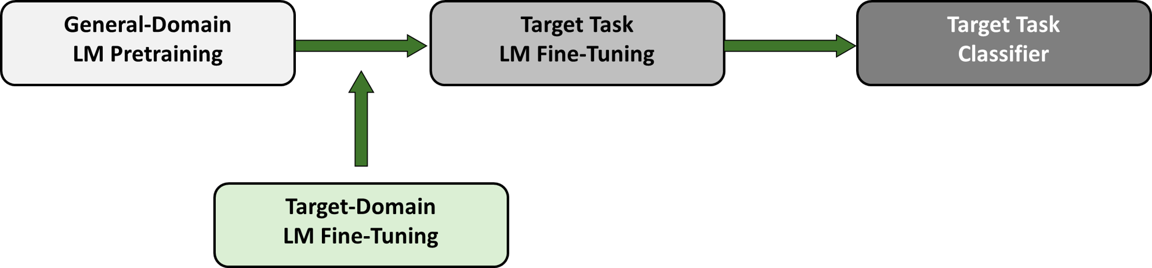
Transfer learning
Pretraining a language model (LM) on a massive corpus of general text
Use the pretrained model and fine tuning for downstream tasks
All state of the art NLP tasks (translation, classification, Q&A, chatbots etc.) all use this general approach
11

Slide 12
Transfer Learning for GoldSpot
Leverages transfer learning using a pre-trained language model, and fine-tuning the model for sentiment classification on our text corpus.
Fine-tuning a language model on our corpus allows the model to gain a general understanding of domain-specific language
This technique enables us to achieve strong accuracy in our classification results at a fraction of the computational cost and data compared to training a classifier from scratch
12

Slide 13
Getting the data

Slide 14
Project Outline
Testing and Monitoring
Gathering Data
Train Model
Finding Key Words
Choosing Classifier Method
Filter Twitter Posts
Annotate Data
Choosing Labels
Notes:
This is a sample pipeline of how we would want to proceed with a project using NLP. This particular project aims to classify tweets about the gold metal on twitter based on their sentiment in order to get a better understanding of whether investors think the gold price will go up or down.
We will start by gathering data, followed by finding keywords, filtering twitter posts, choosing mood dimensions, annotating data, choosing the classifier method, training the model, and testing and monitoring. This will be an iterative process, that will constantly be improved upon.

Slide 15



Gathering Data
Tweepy | Twurl
Free 7 day limit Limited additional information (e.g. location, etc) | Paid (Premium API) Access to full archive Limited keyword search (no cashtags) Access to additional tweet information (e.g. location)
Saved as both .csv and .json file
15
Notes:
Now I’ll go through what I did at each step of the way.
Gathering Data
First, we wanted to start by gathering the data we needed for our sentiment analyzer from Twitter.
Tweets are posts of 280 character or less on the social media application Twitter. Today, Twitter is the champion of microblogging, and is the most popular platform for people to share quick thoughts in their day to day lives. Since Twitter is a widely used platform, many users use this channel to depict their thoughts and feelings on certain stocks/companies to their many followers, which can be analyzed to determine overall mood and to predict stock prices and their direction in the future.
Tweets were downloaded using Tweepy and Twurl. While Twitter has a free version, it limits the tweets accessible to 7 days prior. This was not enough tweets to train our classifier, nor was it a large enough time frame in terms of posted tweets. Thus, we had to purchase Twitter’s Premium API for access to Twitter’s full archive of tweets. While the premium version also has access to an extended amount of information such as tweet location, the available keywords (such as cashtags) were restricted compared to the free version. All tweets were saved as .json files to retain all information, and also into csv file for ease of use.
In this presentation, we’ll mainly be focusing on the free tweets gathered from tweepy. To download your own tweets, you will need to create a Twitter developer account and get approval.

Slide 16
Finding Key Words
Free Query
Premium Query
“((GLD #GOLD) OR (GLD GOLD) OR #GLD)”
“$GLD OR #GLD OR $GOLD”
Notes:
Finding Key Words
Determining the correct keywords is vital to obtaining related tweets. Keywords that are too broad will generate too many unrelated tweets but having a query that is too narrow will not allow us to obtain the full scope of investor sentiment. For Gold (Free Version), the search query “$GLD OR #GLD OR $GOLD” provided a large scope of related tweets. For Gold (Premium Version), the search query is ((GLD #GOLD) OR (GLD GOLD) OR #GLD). Using other keywords related to gold, such as just simply gold, returns too many unrelated tweets, many about winning the gold medal in sports, among other things.

Slide 17
Research On Mood Dimensions
Twitter Mood Predicts the Stock Market by Bollen et. al
Classifed Tweets into Google-Profile of Mood States (GPOMS) that measures mood in terms of 6 dimensions (Calm, Alert, Sure, Vital, Kind, and Happy)
87% accuracy in predicting daily up/down changes of the DJIA
Calm was the most predictive indicator of the change in stock price
An Experiment in Integrating Sentiment Features for Tech Stock Prediction in Twitter by Vu et. al
Used a combination of regular sentiment categories (positive/neutral/negative) and market confidence (bullish/bearish)
75% - 83% accuracies in predicting daily up/down changes of popular tech stocks
Notes:
Research on Mood Dimensions
Sentiment analysis usually focuses on categorizing text into either positive, neutral, or negative. However, these categories would not accurately describe what investors feel about the price of gold. This is due to the existence of shorting stocks, which allows investors to earn money on the stock price drop. If an investor/tweet feels positive about a stock, this can correlate to feeling good about a price increase OR a price drop. Thus, research was done into look at other possible categories to classify the tweets into.
Two particular studies stood out during the research. The first was called Twitter Mood Predicts the Stock Market by Bollen et. Al. This group classifed tweets into the Google-Profile of Mood States (GPOMS) that measures mood in terms of 6 dimensions, Calm, Alert, Sure, Vital, Kind, and Happy. This paper achieved an 87% accuracy in predicting daily up/down changes of the Dow Jones Industrial Average, with the Calm mood being the most predictive indicator of the change in stock price. While this seems like a dream come true, using this method was not feasible. This is because the training data for GPOMS is not available to the public, and thus this experiment cannot be replicated, or tested in different environments. It is also unclear how to determine whether a text is calm, alert, sure, vital, kind, and happy. However, this paper gave good insight into how using different mood dimensions can give better results than just using positive/neutral/negative.
The second study focuses on individual stocks rather than a composite, specifically on popular tech stocks, including Apple, Google, Microsoft, and Amazon. This group achieved a best accuracy ranging from 75% to 83% for the tech companies mentioned previously. To achieve this result, they used a combination of regular sentiment categories (positive/neutral/negative) and market confidence (bullish/bearish).

Slide 18

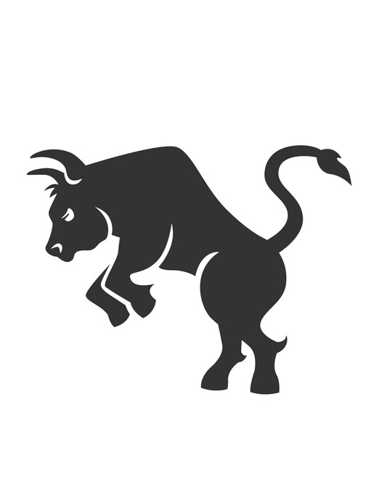


Choosing Mood Dimensions & Annotating Data
Bearish
Sample Tweet:
“$ GLD overbought yet?”
Neutral
Sample Tweet:
“The $GLD inventories print this evening should be interesting.”
Bullish
Sample Tweet:
“$GLD Buy all the Gold you Can!”
Unrelated
Sample Tweet:
“Butterflying off a $QQQ ratio spread.”
Notes:
Choosing Mood Dimensions
Next, we need to choose the classifier categories, and the mood dimensions that these would capture, gathering from the information from the research done previously. Instead of the regular positive/neutral/negative mood dimensions, we decided to classify tweets as bullish/neutral/bearish/unrelated. This would help us better capture market sentiment, and filter out the unrelated, promotional tweets that has overtaken twitter. Here some sample tweets of each category- the bearish one talks about gold being overbought, the neutral one says gold looks interesting but doesn’t have a set position, the bullish one is telling is to buy all the gold we can, and the unrelated one is talking about another stock.

Slide 19
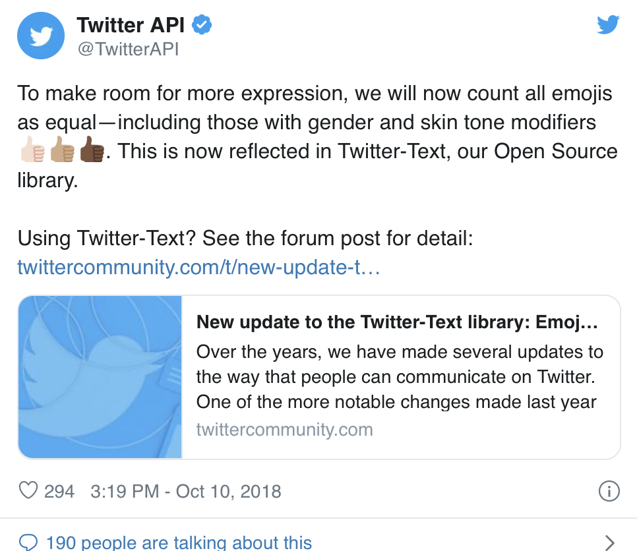
What’s In a Tweet?
Fundamental Attributes
Created Date
ID (int, string)
Text
User Information
Entities
Child Objects
User
User ID (int, string)
Name
Screen name
Location
For full list, see: https://developer.twitter.com/en/docs/tweets/data-dictionary/overview/tweet-object
Notes:
In order to use the tweets, we must understand what exactly is returned when we download the tweets from Twitter. Twitter renders their tweets in JSON. When downloaded, there are many attributes that are given in one single post. The fundamental attributes include the date the tweet was created, the unique ID of the tweet, the text of the tweet, the information of the user that tweeted the tweet, as well as information on entities that have been parsed out of the tweet, such as hashtags, URLs, and polls. Child objects refer to additional objects that are related to the parent, fundamental objects. For example, the User object contains child objects such as the unique user ID, the user name/ twitter handle, the user screen name, their location, and much more. If you’re interested in seeing the depth of the information provided, you can go on the twitter developer website, where they have a list of attributes associated with the tweet objects. For the purposes of this presentation, the attributes we will be focusing on are the unique tweet ID, the username of the person who tweeted it, the date the user tweeted, the text, and the location.

Slide 20
Let’s look at some code!
Notes:
Now that we’ve determine how we should collect the tweets and how we want to categorize them, let’s download some tweets!

Slide 21
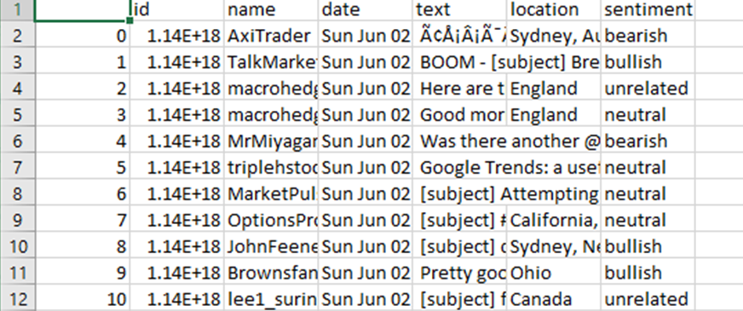
Annotating Tweets – Sample Chart
Notes:
Annotate Data
After deciding on the mood dimensions and gathering the data from Twitter, we needed to annotate the tweets to use as training and validation data. The current classifier is trained used tweets I annotated myself (around 6k tweets). This is a sample of the csv file, which contains the id, name of user, post time, full text of the tweet, and sentiment.

Slide 22
Annotating Tweets
Total Tweets Needed
Goal: 20K Tweets
- 5K tweets per category
68.5%
Tweets Annotated
31.5%
Notes:
These tweets are mostly unrelated tweets, with a small amount being actually relevant (around 19%), as seen in the figure on the left. However, we have already paid someone to annotate around 20k tweets for us, which will hopefully increase the accuracy of the classifier. Our goal is to have at least 5k tweets per category, as shown on the right.

Slide 23
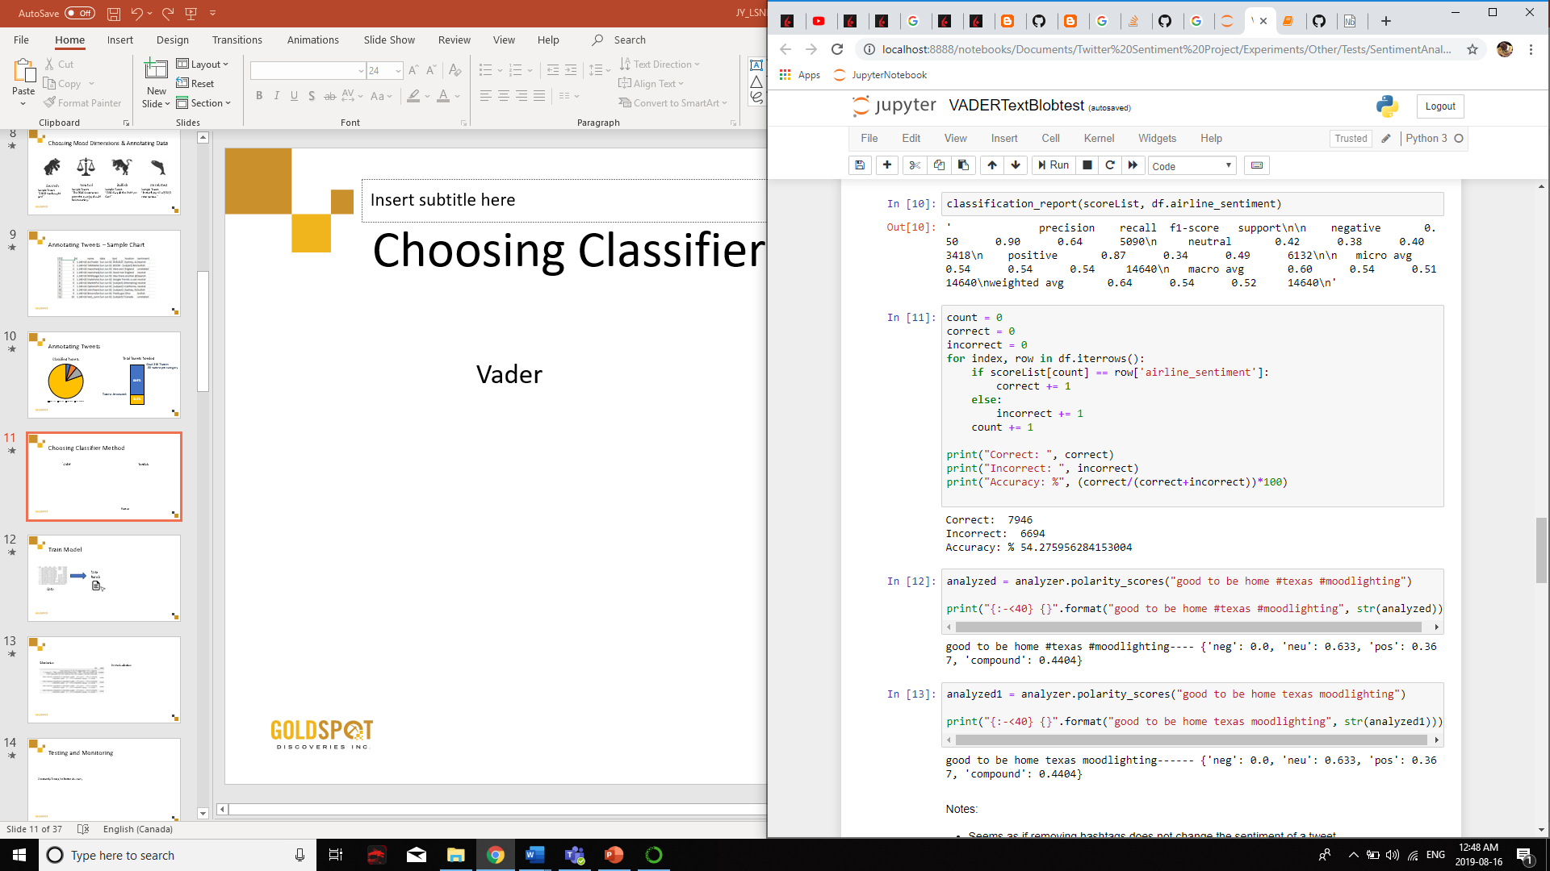
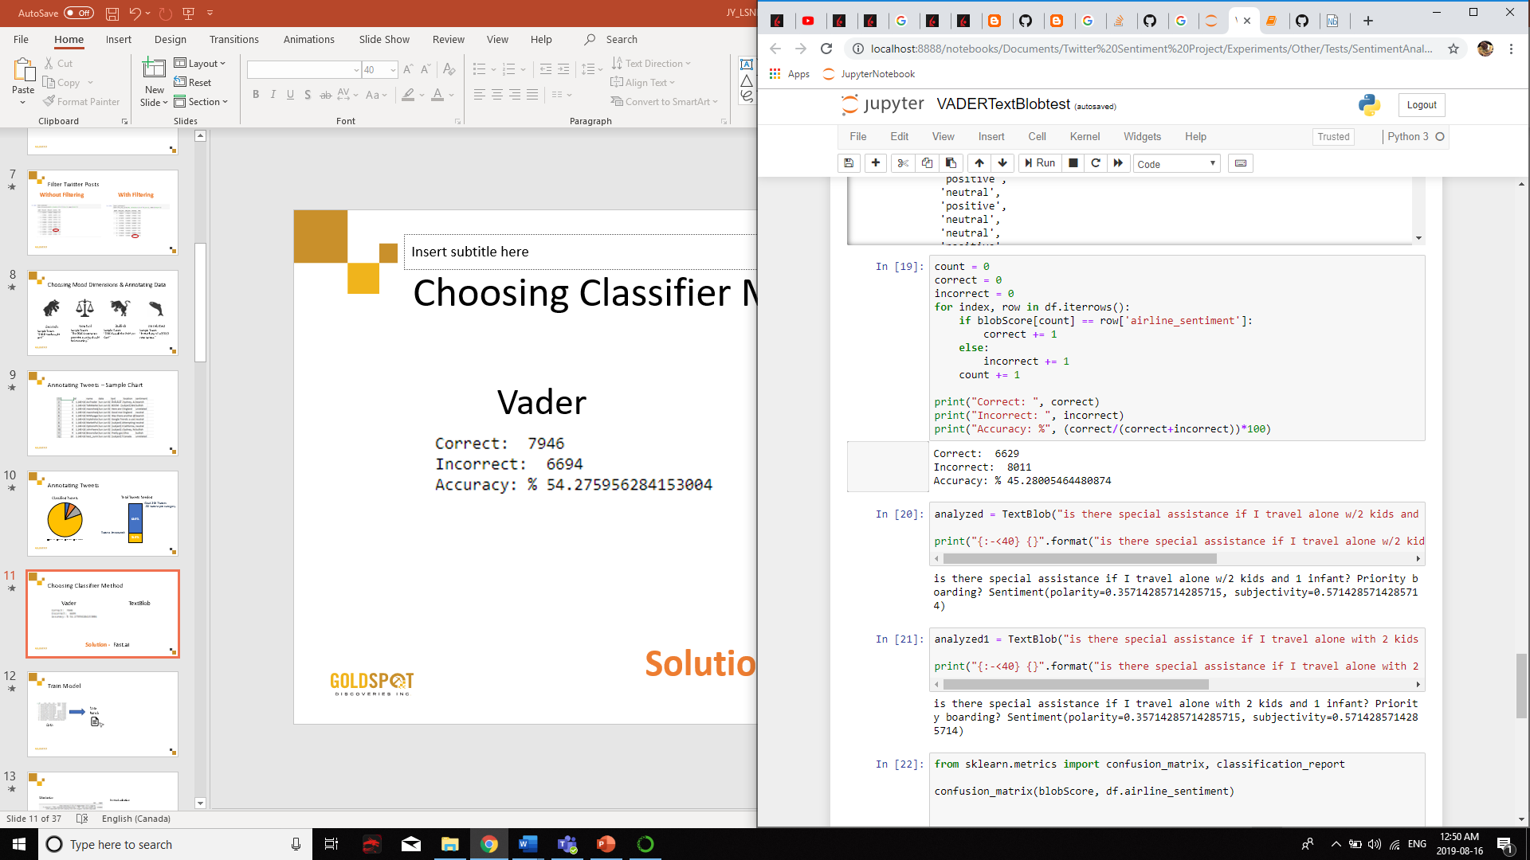
Comparing with BOW apporaches
VADER
TextBlob
Solution -
Transfer learning
Notes:
Choosing Classifier Method
After testing out pretrained sentiment classifiers, such as VADER and TextBlob, we determined that training our own classifier would be the best method due to the financial jargon commonly encountered that has different meanings out of context. The VADER sentiment analyzer is well known for its incorporation of emojis into its sentiment decision. However, as you can see the VADER classifier had an accuracy of around 54%, and TextBlob. Another popular text analyzer, had an accuracy of around 45%. At the time, I did not have a lot of annotated tweets about gold, so these results were determine using a dataset found on Kaggle which labelled the sentiment of tweets in relation to airline customer experience. Due to these low numbers on regular tweets, we decided to use the fast.ai library to train our own classifier. This would allow us to tailor the language more towards the combination of finance and twitter.

Slide 24
ULM-FiT

Slide 25
ULM-FiT
Universal Language Model Fine Tuning - Howard, Ruder (2018)
Uses Recurrent Neural Networks (LSTM) pre-trained on WikiText-103 Dataset
Even though LSTMs have fallen out of favour in current NLP research, they still have several advantages over larger transformer models:
Smaller memory footprint
Faster training/inference
Much less resource intensive
Competitive performance, especially for classification tasks
25

Slide 26


Overview: RNNs and LSTMs
26
Notes:
The most common way to let the NN remember information from previous timesteps is to use a RNN
Explain RNNs
Explain LSTM

Slide 27
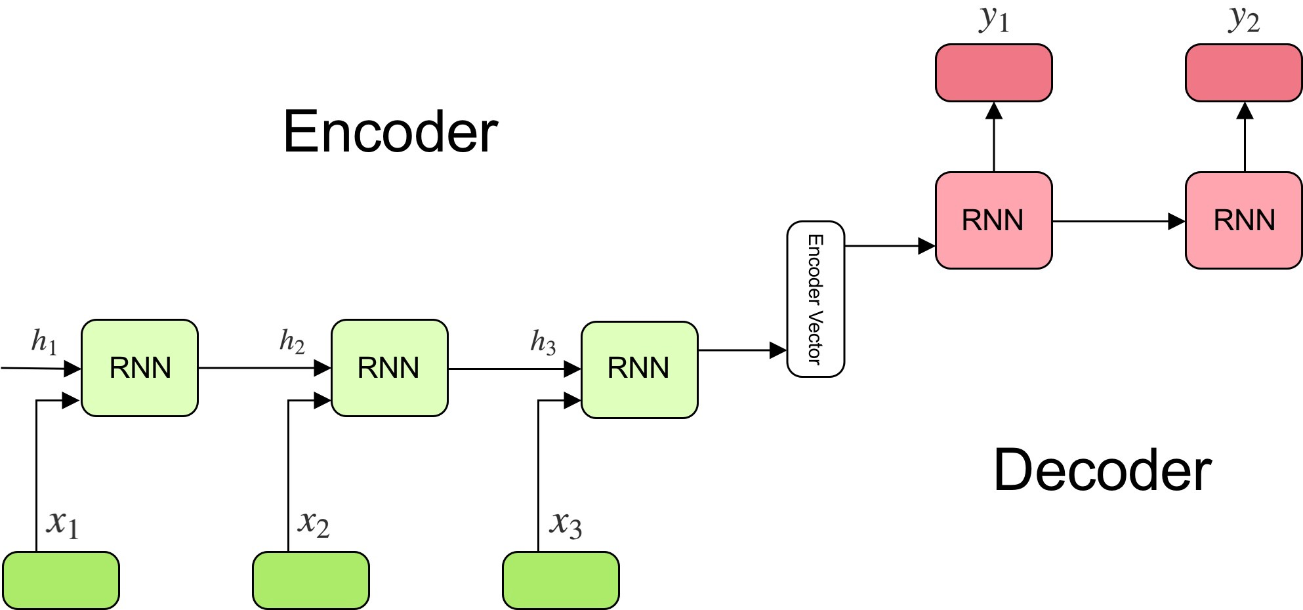
Language Modelling
Training a neural network to predict the next word in a sentence
Example: The weather for Thursday is predicting 5 cm of ________
Uses two RNNs, an encoder and a decoder
27

Slide 28
Using Fastai
We will be using the fastai library to do transfer learning
Makes the process very smooth and easy
Also includes a lot of different tricks to help improve accuracy
The main model we will be using is called AWD-LSTM
https://github.com/salesforce/awd-lstm-lm
3 layer LSTM with a lot of regularization
28

Slide 29
Training the model
Go to notebook
29

Slide 30
Using Transformers

Slide 31

Transformers
Neural networks that replaces LSTMs with Attention modules
Current state of the art in NLP, performs much better than LSTMs for various NLP tasks
Doesn’t compress memory into a fixed-sized hidden state vector
Better long-term modelling
Avoids vanishing/exploding gradients
Easier to scale up compute (parallelizable)
Much harder to train than LSTMs, LSTMs are a much more reasonable starting point when working with a fairly small dataset
http://jalammar.github.io/illustrated-transformer/
31
Notes:
Go over transfomers, encoder, decoder, attention

Slide 32
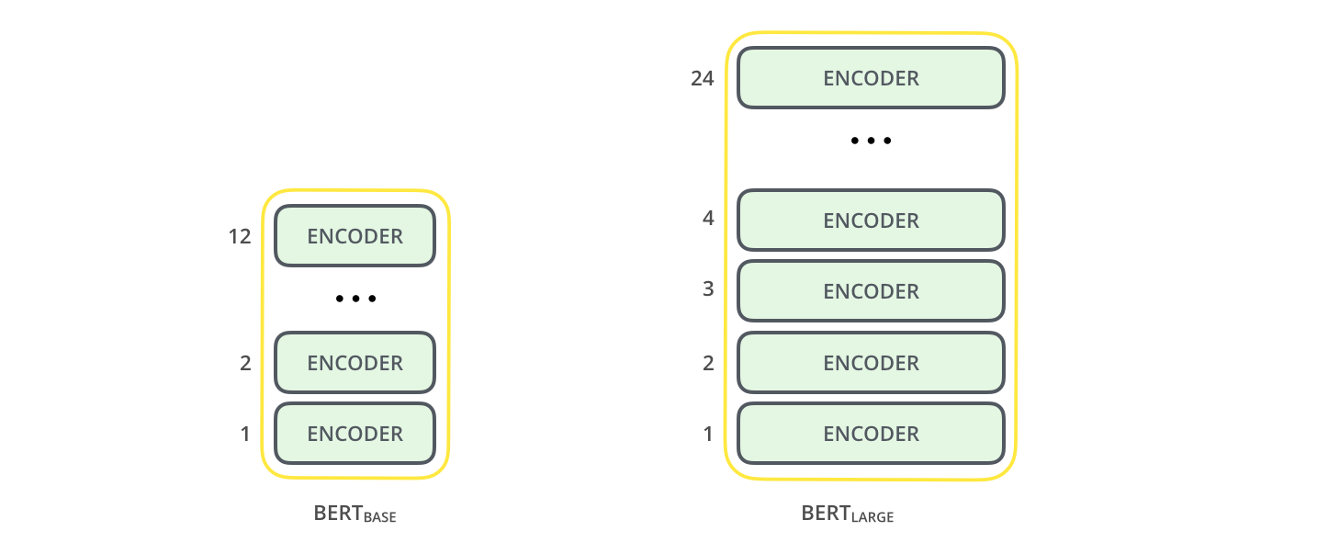
BERT
Model from Google
Bidirectional Encoder Representations with Transformers
2 changes from base transformer network
Bi-directional LM training
Stacking encoders
https://www.blog.google/products/search/search-language-understanding-bert/
Pre-trained models available by Huggingface
https://github.com/huggingface/transformers
32

Slide 33
Pre-training BERT
BERT does not use language modelling for the semi-supervised portion of training
Instead, BERT masks 15% of words during training in order to predict the masked words
Input: the man went to the [MASK1] . he bought a [MASK2] of milk.
Labels: [MASK1] = store; [MASK2] = gallon
BERT also uses next sentence prediction (NSP), which predicts whether or not the following sentence is the correct next sent
33

Slide 34
RoBERTa
Same BERT model, but trained differently
trained for longer, on more data (10x more data)
Dynamic masking, dropped NSP
Different hyperparameters
State of the art on many benchmark tests
34

Slide 35
Training with BERT/RoBERTa
No domain-specific LM fine-tuning.
See notebook
35
Notes:
No lm fine-tuning:because the model is already trained on such a large corpus (GBs of text data), we don’t need to pre-train the model more on a domain specific corpus
Plus it’s so computationally intensive to train BERT, the cost-benefit doesn’t seem to favor further domain specific language modelling
Some

Slide 36
BERT vs AWD-LSTM
BERT | AWD-LSTM
No autoregressive bias Very large model, 110M+parameters Very slow training Easier to scale SOTA results on many NLP tasks | Autoregressive bias Smaller model (approx. 24M parameters) Faster to train with smaller data Much harder to scale due to LSTM layer Competitive results in classification and language modelling Worse performance in other NLP tasks (translation, question answering, etc.)
36
Notes:
Autoregressive bias:
For rnns, when you look at a word, you have to have looked at all the words before it, but nothing after it (sequential)
By contrast for Transformers, when you look at a word, you’re computing its attention between that word and all the words in that sequence (and that can be parallelized)
Harder to scale:
- Because when you use rnns, it has to be sequential, it makes it much harder to scale into larger model with much more layers

Slide 37
Improvements

Slide 38
Improvements to the baseline model
More data!
Use oversampling to deal with imbalanced data
Improve AWD-LSTM
Change drop_mult
Train with lower learning rate on the unfrozen model
Train a backwards model and ensemble
Use RoBERTa
Ensemble models
See notebook
Note: choose an appropriate balance between accuracy and practicality
38
Notes:
ROBERTA – BERT but trained differently
The model is trained longer (100k-500K steps)
bigger batch sizes (they train with batch size of 4K sequences in contrast to BERT base trained on 256 sequences)
more data 16G -> 160G of text ( e.g. a new corpus CC-NEWS subset of Common Crawl)
removing next sentence prediction (they report slight improvement in downstream tasks by removing this)
training on longer sequences (full contiguous sentences without next sentence prediction)
dynamically changing the masking pattern applied to training data (BERT masking is done during preprocessing. Instead they perform masking dynamically on each sentence.)
Larger vocabulary of 50K subword units as opposed to BERT 30k units
Different hyperparameters
Basically SOTA

Slide 39
Thank you for listening
Any Questions?
39

